Slide 1
3413ICT Network Security
Access Control
Dr V. Muthukkumarasamy
B.Sc.Eng (Hons) (Peradeniya), PhD (Cantab), MIEE, MIEEE

Slide 2
Previous Lectures…
Have studied…
Network intrusions
Why anomaly detection
Classification-based techniques

Slide 3
Today’s Objectives
Access control principles
Access control policies
Access control requirements
Access control elements
Discretionary access control
Role-based access control
A case study
Access control models
Notes:
Now look at a simple form of encryption based on two concepts: the block cipher and the stream cipher.
Stream ciphers are based on a PRNG. The strength of the cipher depends on just how good the PRNG is. Good algorithms employ a lot of state and are highly secure. Stream ciphers must never re-use the same key and many mistakes occur because of this (Word/Excel encryption, WEP and so on).
With the block cipher method, the message is divided into blocks, i.e., 64 or 128 bit blocks, and then each block is transformed using the algorithm and key.

Slide 4
References
Textbook:
Computer Security Principles and Practice (2nd Ed.),
W. Stallings & L. Brown
Chapter 4

Slide 5
Access Control
The prevention of unauthorized use of a resource, including the prevention of use of a resource in an unauthorized manner
Access control is the central element of computer and network security
Assumption: users and groups
are able to authenticate to the system;
And they are assigned access rights to certain resources
Notes:
This lesson focuses on access control enforcement within a computer system. We can view access control as the central element of computer security. ITU-T Recommendation X.800 defines access control as shown on the slide. The principal objectives of computer security are to prevent unauthorized users from gaining access to resources, to prevent legitimate users from accessing resources in an unauthorized manner, and to enable legitimate users to access resources in an authorized manner. We consider the situation of a population of users and user groups that are able to authenticated to a system and are then assigned access rights to certain resources on the system.

Slide 6
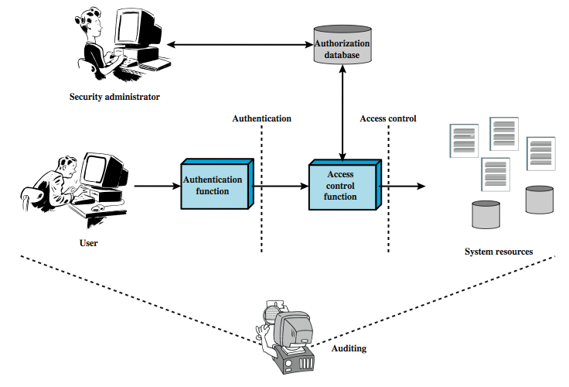
Access Control & AAA Functions
Notes:
This chapter deals with a narrower, more specific concept of access control which implements a security policy that specifies who or what may have access to each specific system resource and the type of access that is permitted in each instance. Figure 4.1 from the text shows the broader context of access control. In addition to access control, this broader context involves the following entities and functions:
• Authentication: The verification an identity claimed by or for a system entity.
• Authorization: The granting of a right or permission to a system entity to access a system resource. This function determines who is trusted for a given purpose.
• Audit: An independent review and examination of system records and activities in order to test for adequacy of system controls, to ensure compliance with established policy and operational procedures, to detect breaches in security, and to recommend any indicated changes in control, policy and procedures.
An access control mechanism mediates between a user (or a process executing on behalf of a user) and system resources, such as files and database. The system must first authenticate a user seeking access. Then, the access control function determines if the specific requested access by this user is permitted. A security administrator maintains an authorization database that specifies what type of access to which resources is allowed for this user. The access control function consults this database to determine whether to grant access. An auditing function monitors and keeps a record of user accesses to system resources. All operating systems have at least a rudimentary, and in many cases a quite robust, access control component. Particular applications or utilities, such as a database management system, also incorporate access control functions.

Slide 7
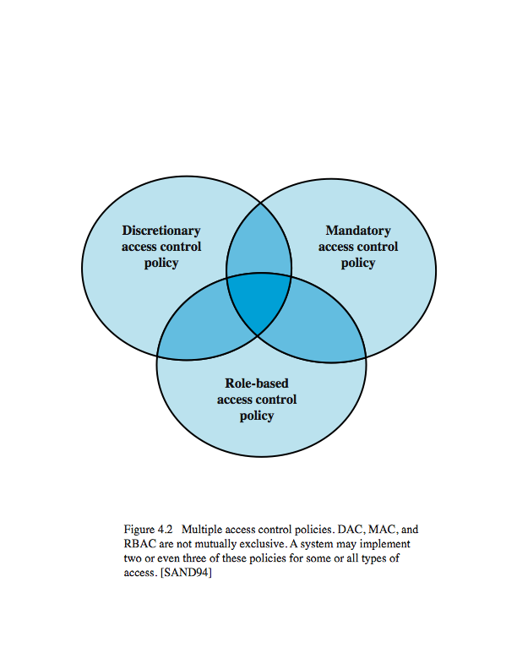
Access Control Policies
Three categories of access control policies:
Discretionary access control (DAC): Controls access based on the identity of the requestor. It is called discretionary because an entity may have rights to enable other entities to access the resources
Mandatory access control (MAC): Controls access based on comparing the security labels of the objects with security clearances of the entity. Mandatory: an entity that has the clearance to access a resource may not, just by its own volition, enable other entities to access the resource
Role-based access control (RBAC): Controls access based on the roles of the user and on rules defining what accesses are allowed to users in the given roles
Notes:
An access control policy, which is embodied in an authorization database, dictates what types of access are permitted, under what circumstances, and by whom. Access control policies are generally grouped into the following access control categories:
• Discretionary access control (DAC): based on the identity of the requestor and on access rules (authorizations) stating what requestors are (or are not) allowed to do. This policy is termed discretionary because an entity might have access rights that permit the entity, by its own volition, to enable another entity to access some resource.
• Mandatory access control (MAC): based on comparing security labels (which indicate how sensitive or critical system resources are) with security clearances (which indicate system entities are eligible to access certain resources). This policy is termed mandatory because an entity that has clearance to access a resource may not, just by its own volition, enable another entity to access that resource. See chapter 10.
• Role-based access control (RBAC): based on the roles that users have within the system and on rules stating what accesses are allowed to users in given roles.
DAC is the traditional method of implementing access control. MAC is a concept that evolved out of requirements for military information security and is best covered in the context of trusted systems. RBAC has become increasingly popular. These three policies are not mutually exclusive as shown in Figure 4.2. Can employ two or even all three of these policies to cover different classes of system resources.

Slide 8
Access Control Requirements
Reliable input – In addition to authentication mechanism, other inputs (such as source IP address) must also be reliable. The system must have a means of determining the validity of the source
Least privilege – An entity should be granted the minimum resources that are required to do its work
Open and closed policies – Closed policy: only accesses that are specially authorized are allowed / Open policy: authorizations specify which accesses are prohibited, all other accesses are allowed
Policy combinations and conflict resolution – An access control mechanism may apply multiple policies – it requires to avoid any potential conflicts
Administrative policies – Administrative policies are needed to specify who can add, delete, or modify authorization rules
Notes:
[VIME06] lists the following concepts features of an access control system:
• Reliable input: it assumes that a user is authentic; thus, an authentication mechanism is needed as a front end to an access control system. Other inputs to the access control system must also be reliable.
• Support for fine and coarse specifications: fine-grained specifications allow access regulated at the level of individual fields / records in files; and each individual access by a user rather than a sequence of accesses. System administrators should also be able to choose coarse-grain specification for some classes of resource access.
• Least privilege: it should be implemented so that each system entity is granted the minimum system resources and authorizations needed to do its work. This principle tends to limit damage that can be caused by an accident, error, or unauthorized act.
• Separation of duty: should divide steps in a system function among different individuals, so as to keep a single individual from subverting the process.
• Open and closed policies: a closed policy only allows accesses that are specifically authorized; an open policy allows all accesses except those expressly prohibited.
• Policy combinations and conflict resolution: may apply multiple policies to a given class of resources, and need a procedure to resolves conflicts between policies.
• Administrative policies: to specify who can add, delete, or modify authorization rules, and also need access control and other control mechanisms to enforce these administrative policies.

Slide 9
Access Control Elements
Subject – entity that can access objects
a process representing user/application
often have 3 classes: owner, group, world
Object – resource to which access is controlled
e.g. files, directories, records, programs etc
number/type depend on environment
Access right – way in which subject accesses an object
e.g. read, write, execute, delete, create, search
Notes:
The basic elements of access control are: subject, object, and access right.
A subject is an entity capable of accessing objects, usually a process. Any user or application actually gains access to an object by means of a process that represents it. A subject is typically held accountable for the actions they have initiated, and an audit trail may be used to associate with a subject and security-relevant actions performed on an object. Basis access control systems typically define three classes of subject:
• Owner: This may be the creator of a resource, such as a file. For system resources, ownership may belong to a system administrator. For project resources, a project administrator or leader my be assigned ownership.
• Group: In addition to the privileges assigned to an owner, a named group of users may also be granted access rights, such that membership in the group is sufficient to exercise these access rights.
• World: The least amount of access is granted to users who are able to access the system but are not included in the categories owner and group for this resource.
An object is any resource to which access is controlled. In general, and object is an entity used to contain and/or receive information. Examples include records, blocks, pages, segments, files, portions of files, directories, directory trees, mailboxes, messages, and programs. The number and types of objects to be protected by an access control system depends on the environment in which access control.
An access right describes the way in which a subject may access an object. Access rights could include the following: read, write, execute, delete, create, search.

Slide 10
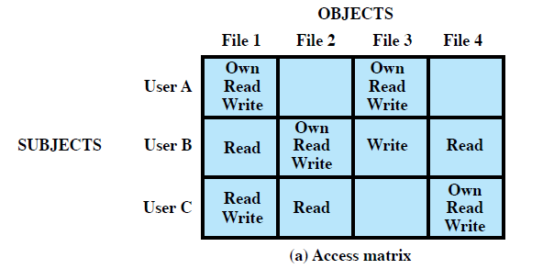
Discretionary Access Control (DAC)
A general approach to DAC, as exercised by operation systems or database management systems, is that of an access matrix
lists subjects in one dimension
lists objects in the other dimension
each entry specifies access rights of the specified subject to that object
Access matrix is often sparse
Notes:
For discretionary access control, a general approach to access control as exercised by an operating system or a database management system is that of an access matrix. One dimension of the matrix consists of identified subjects that may attempt data access. Typically, this list will consist of individual users or user groups, although access could be controlled for terminals, hosts, or applications instead of or in addition to users. The other dimension lists the objects that may be accessed. At the greatest level of detail, objects may be individual data fields. More aggregate groupings, such as records, files, or even the entire database, may also be objects in the matrix. Each entry in the matrix indicates the access rights of that subject for that object. In practice, an access matrix is usually sparse and is implemented by decomposition in one of two ways, as we show on the next slide.

Slide 11
Access Matrix
The access matrix can be decomposed by columns – yielding access control lists (ACLs)
Easy to determine which subjects have which access rights, to a particular resource
Not convenient to determine the access rights available, to a specific user
Decomposition by rows yields capability tickets
A capability ticket specifies authorized object & operations for a particular user
Notes:
Figure 4.3a from the text illustrates a simple example of an access matrix. Thus, user A owns files 1 and 3 and has read and write access rights to those files. User B has read access rights to file 1, and so on. In practice, an access matrix is usually sparse and is implemented by decomposition in one of two ways.
The matrix may be decomposed by columns, yielding access control lists (ACLs); as shown in Figure 4.3b. For each object, an ACL lists users and their permitted access rights. The ACL may contain a default, or public, entry. This allows users that are not explicitly listed as having special rights to have a default set of rights. Elements of the list may include individual users as well as groups of users. When it is desired to determine which subjects have which access rights to a particular resource, ACLs are convenient, because each ACL provides the information for a given resource. However, this data structure is not convenient for determining the access rights available to a specific user.
Decomposition by rows yields capability tickets, shown in Figure 4.3c. A capability ticket specifies authorized objects and operations for a user. Each user has a number of tickets and may be authorized to loan or give them to others. Because tickets may be dispersed around the system, they present a greater security problem than access control lists. In particular, the ticket must be unforgeable. One way to accomplish this is to have the operating system hold all tickets on behalf of users. These tickets would have to be held in a region of memory inaccessible to users. The convenient and inconvenient aspects of capability tickets are the opposite of those for ACLs. It is easy to determine the set of access rights that a given user has, but more difficult to determine the list of users with specific access rights for a specific resource.

Slide 12
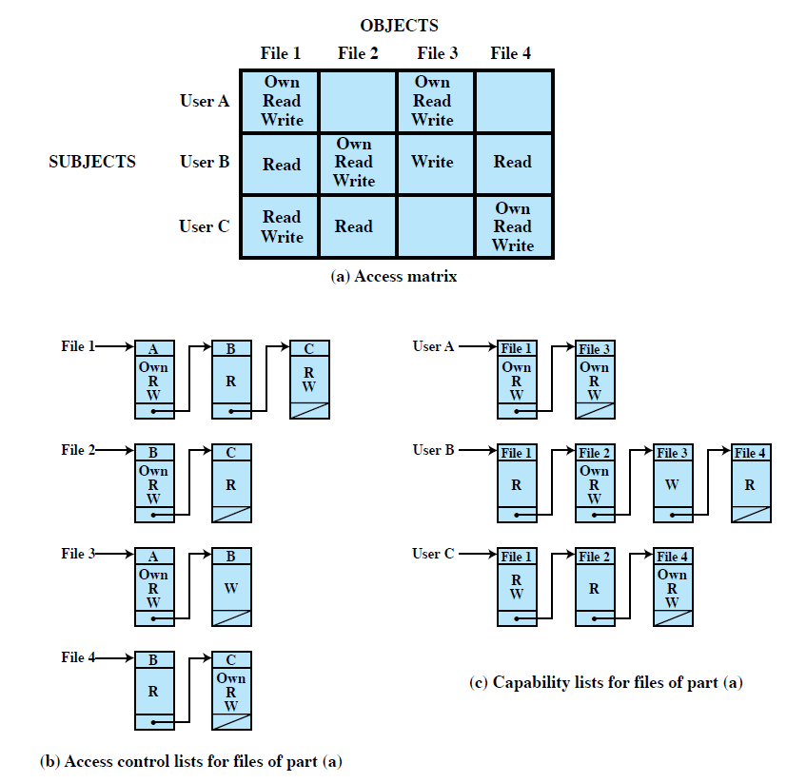
Access Matrix
Notes:
Figure 4.3a from the text illustrates a simple example of an access matrix. Thus, user A owns files 1 and 3 and has read and write access rights to those files. User B has read access rights to file 1, and so on. In practice, an access matrix is usually sparse and is implemented by decomposition in one of two ways.
The matrix may be decomposed by columns, yielding access control lists (ACLs); as shown in Figure 4.3b. For each object, an ACL lists users and their permitted access rights. The ACL may contain a default, or public, entry. This allows users that are not explicitly listed as having special rights to have a default set of rights. Elements of the list may include individual users as well as groups of users. When it is desired to determine which subjects have which access rights to a particular resource, ACLs are convenient, because each ACL provides the information for a given resource. However, this data structure is not convenient for determining the access rights available to a specific user.
Decomposition by rows yields capability tickets, shown in Figure 4.3c. A capability ticket specifies authorized objects and operations for a user. Each user has a number of tickets and may be authorized to loan or give them to others. Because tickets may be dispersed around the system, they present a greater security problem than access control lists. In particular, the ticket must be unforgeable. One way to accomplish this is to have the operating system hold all tickets on behalf of users. These tickets would have to be held in a region of memory inaccessible to users. The convenient and inconvenient aspects of capability tickets are the opposite of those for ACLs. It is easy to determine the set of access rights that a given user has, but more difficult to determine the list of users with specific access rights for a specific resource.

Slide 13
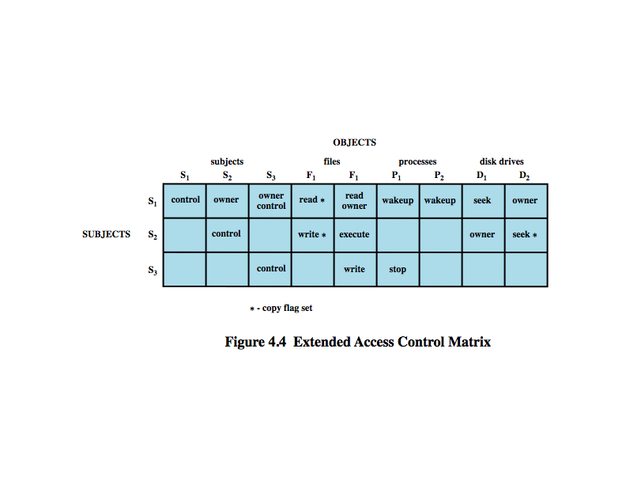
A Scheme for DAC
A well-known scheme was developed by Lampson, Graham, and Denning, in 1971 (which is called LGD scheme)
Based on an extended access control matrix
13
Notes:
13
For discretionary access control, a general approach to access control as exercised by an operating system or a database management system is that of an access matrix. One dimension of the matrix consists of identified subjects that may attempt data access. Typically, this list will consist of individual users or user groups, although access could be controlled for terminals, hosts, or applications instead of or in addition to users. The other dimension lists the objects that may be accessed. At the greatest level of detail, objects may be individual data fields. More aggregate groupings, such as records, files, or even the entire database, may also be objects in the matrix. Each entry in the matrix indicates the access rights of that subject for that object. In practice, an access matrix is usually sparse and is implemented by decomposition in one of two ways, as we show on the next slide.

Slide 14
How LGD Scheme Works?
Let A represent the extended access control matrix, A[S, X] represents the set of access rights of subject S to object X
An access attempt triggers the following steps:
A subject S issues a request of type a access to object X
The request cause the system (such as an access control module) to generate a message of the form (S, a, X) to the controller for X
The controller check the matrix A, to determine if a is in A[S, X]. If so, the access is allowed; if not, a warning (or other appropriate action) will be triggered
14
Notes:
14
For discretionary access control, a general approach to access control as exercised by an operating system or a database management system is that of an access matrix. One dimension of the matrix consists of identified subjects that may attempt data access. Typically, this list will consist of individual users or user groups, although access could be controlled for terminals, hosts, or applications instead of or in addition to users. The other dimension lists the objects that may be accessed. At the greatest level of detail, objects may be individual data fields. More aggregate groupings, such as records, files, or even the entire database, may also be objects in the matrix. Each entry in the matrix indicates the access rights of that subject for that object. In practice, an access matrix is usually sparse and is implemented by decomposition in one of two ways, as we show on the next slide.

Slide 15
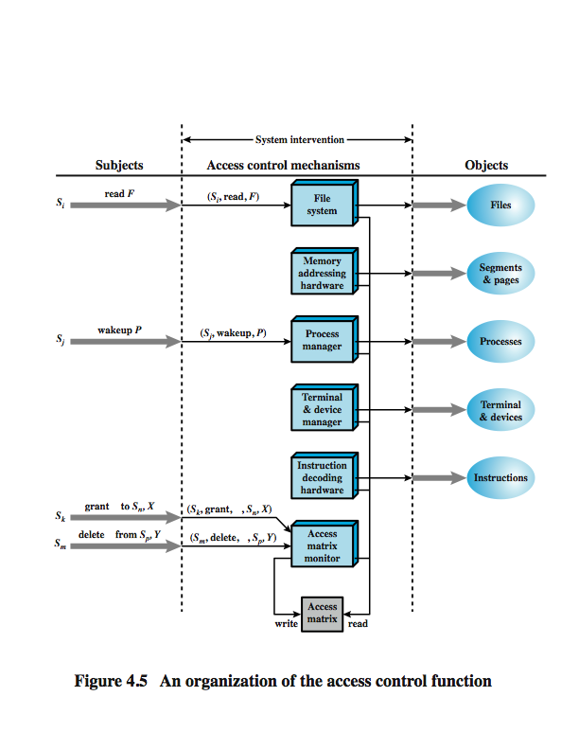
Notes:
From a logical or functional point of view, a separate access control module is associated with each type of object, as shown in Figure 4.5. The module evaluates each request by a subject to an object to determine if the access right exists. An access attempt triggers the following steps:
A subject S₀ issues a request of type α for object X.
The request causes the system (operating system or an access control interface module) to generate a message of the form (S₀, α, X) to the controller for X
The controller interrogates the access matrix A to determine if α is in A[S₀, X]. If so, the access is allowed, if not the access is denied and a protection violation occurs.
Figure 4.5 suggests that every access by a subject to an object is mediated by the controller for that object, and that the controller's decision is based on the current contents of the matrix. In addition, certain subjects have the authority to make specific changes to the access matrix. A request to modify the access matrix is treated as an access to the matrix, with the individual entries in the matrix treated as objects. Such accesses are mediated by an access matrix controller, which controls updates to the matrix. The model also includes a set of rules that govern modifications to the access matrix, such as those shown in Table 4.2 in the text. These include means of accessing, transferring, granting, and deleting access rights; and with who can create and delete subjects and objects. The ability of one subject to create another subject and to have 'owner' access right to that subject can be used to define a hierarchy of subjects. For example, in Figure 4.4 on the previous slide, S₁ owns S₂ and S₃, so that S₂ and S₃ are subordinate to S₁.

Slide 16
LGD Rules
LGD scheme includes a set of rules that govern modifications
to the access matrix A (see the following Rule Table)
16
Notes:
16
For discretionary access control, a general approach to access control as exercised by an operating system or a database management system is that of an access matrix. One dimension of the matrix consists of identified subjects that may attempt data access. Typically, this list will consist of individual users or user groups, although access could be controlled for terminals, hosts, or applications instead of or in addition to users. The other dimension lists the objects that may be accessed. At the greatest level of detail, objects may be individual data fields. More aggregate groupings, such as records, files, or even the entire database, may also be objects in the matrix. Each entry in the matrix indicates the access rights of that subject for that object. In practice, an access matrix is usually sparse and is implemented by decomposition in one of two ways, as we show on the next slide.

Slide 17
LGD Rules
In the Rule Table (on the previous slide): R1 deals with access right transfer
If a* is in A[S₀, X], then S₀ has access right a, and can transfer this right to another subject
R2 states that if S₀ is designated as the “owner” of object X, then S₀ can grant an access right (even with the copy flag) to X to any to any other subject
R3 permits S₀ to delete any access right to object X from subject S, if S₀ “controls” S or S₀ owns X
R7 enables any subject, say, S₀, to create a new subject S
S₀ owns S (that is, S is “subordinate” of S₀)
S has control access to itself
17
Notes:
17
For discretionary access control, a general approach to access control as exercised by an operating system or a database management system is that of an access matrix. One dimension of the matrix consists of identified subjects that may attempt data access. Typically, this list will consist of individual users or user groups, although access could be controlled for terminals, hosts, or applications instead of or in addition to users. The other dimension lists the objects that may be accessed. At the greatest level of detail, objects may be individual data fields. More aggregate groupings, such as records, files, or even the entire database, may also be objects in the matrix. Each entry in the matrix indicates the access rights of that subject for that object. In practice, an access matrix is usually sparse and is implemented by decomposition in one of two ways, as we show on the next slide.

Slide 18
Role-Based Access Control (RBAC)
RBAC systems assign access rights to roles instead of individual users
Users are assigned to different roles, either statically or dynamically
RBAC now enjoys widespread commercial use and remains an area of active research
NIST standard (FIPS PUB 140-2, 2001) supports RBAC
The relationship of users and roles is many to many, as the relationship of roles to resources
Users change frequently / roles, resources, and access rights for each role are relatively static
Notes:
Now define some basic concepts concerning UNIX files and directories.
All types of UNIX files are administered by the operating system by means of inodes. An inode (index node) is a control structure that contains the key information needed by the operating system for a particular file. Several file names may be associated with a single inode, but an active inode is associated with exactly one file, and each file is controlled by exactly one inode. The attributes of the file as well as its permissions and other control information are stored in the inode. On the disk, there is an inode table, or inode list, that contains the inodes of all the files in the file system. When a file is opened, its inode is brought into main memory and stored in a memory-resident inode table.
Directories are structured in a hierarchical tree. Each directory can contain files and/or other directories. A directory that is inside another directory is referred to as a subdirectory. A directory is simply a file that contains a list of file names plus pointers to associated inodes. Thus, associated with each directory is its own inode.

Slide 19
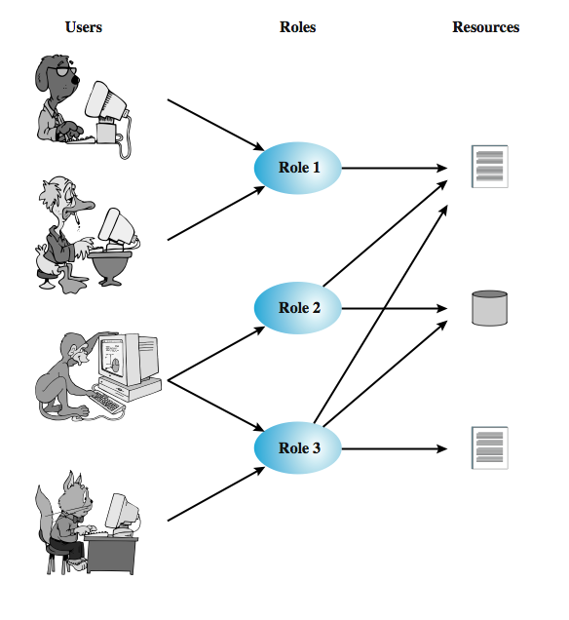
RBAC –Roles, Users, & Resources
Notes:
Traditional DAC systems define the access rights of individual users and groups of users. In contrast, RBAC is based on the roles that users assume in a system rather than the user's identity. Typically, RBAC models define a role as a job function within an organization. RBAC systems assign access rights to roles instead of individual users. In turn, users are assigned to different roles, either statically or dynamically, according to their responsibilities. RBAC now enjoys widespread commercial use and remains an area of active research.
The relationship of users to roles is many to many, as is the relationship of roles to resources, or system objects, as shown here in Figure 4.7 from the text. The set of users changes, in some environments frequently and the assignment of a user to one or more roles may also be dynamic. The set of roles in the system in most environments is likely to be static, with only occasional additions or deletions. Each role will have specific access rights to one or more resources. The set of resources and the specific access rights associated with a particular role are also likely to change only infrequently.

Slide 20
Matrix Representation of RBAC
Key element of an RBAC system can be represented by matrices
One matrix represent the relationship of users to roles
Rows indicate users / columns indicate roles
Typically there are many more users than roles
A single users may be assigned multiple roles / A single role may be taken by multiple users
The relationship of roles to resources is represented by another matrix, which has the same structure as the DAC access control matrix
A role can be treated as an object, allowing the definition of role hierarchies
Least privilege principle: Each role is only assigned the minimum set of access rights needed for the role
Notes:
Now define some basic concepts concerning UNIX files and directories.
All types of UNIX files are administered by the operating system by means of inodes. An inode (index node) is a control structure that contains the key information needed by the operating system for a particular file. Several file names may be associated with a single inode, but an active inode is associated with exactly one file, and each file is controlled by exactly one inode. The attributes of the file as well as its permissions and other control information are stored in the inode. On the disk, there is an inode table, or inode list, that contains the inodes of all the files in the file system. When a file is opened, its inode is brought into main memory and stored in a memory-resident inode table.
Directories are structured in a hierarchical tree. Each directory can contain files and/or other directories. A directory that is inside another directory is referred to as a subdirectory. A directory is simply a file that contains a list of file names plus pointers to associated inodes. Thus, associated with each directory is its own inode.

Slide 21
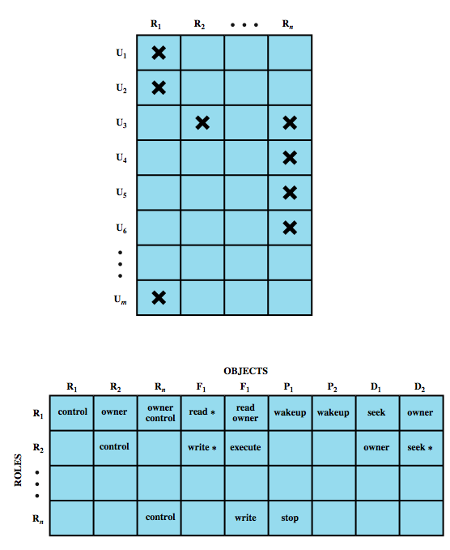
Matrix Representation of RBAC
Notes:
We can use the access matrix representation to depict the key elements of an RBAC system in simple terms, as shown in Figure 4.8. The upper matrix relates individual users to roles. Typically there are many more users than roles. Each matrix entry is either blank or marked, the latter indicating that this user is assigned to this role. Note that a single user may be assigned multiple roles (more than one mark in a row) and that multiple users may be assigned to a single role (more than one mark in a column). The lower matrix has the same structure as the DAC access control matrix, with roles as subjects. Typically, there are few roles and many objects, or resources. In this matrix the entries are the specific access rights enjoyed by the roles. Note that a role can be treated as an object, allowing the definition of role hierarchies.
RBAC lends itself to an effective implementation of the principle of least privilege. Each role should contain the minimum set of access rights needed for that role. A user is assigned to a role that enables him or her to perform only what is required for that role. Multiple users assigned to the same role, enjoy the same minimal set of access rights.

Slide 22
Role Hierarchies of RBAC
Role hierarchies provide a means of reflecting the hierarchical structure of roles in an organization
Job functions with greater responsibility have greater authority to access resources
A subordinate job function may have a subset of the access rights of the superior job function
Notes:
Now define some basic concepts concerning UNIX files and directories.
All types of UNIX files are administered by the operating system by means of inodes. An inode (index node) is a control structure that contains the key information needed by the operating system for a particular file. Several file names may be associated with a single inode, but an active inode is associated with exactly one file, and each file is controlled by exactly one inode. The attributes of the file as well as its permissions and other control information are stored in the inode. On the disk, there is an inode table, or inode list, that contains the inodes of all the files in the file system. When a file is opened, its inode is brought into main memory and stored in a memory-resident inode table.
Directories are structured in a hierarchical tree. Each directory can contain files and/or other directories. A directory that is inside another directory is referred to as a subdirectory. A directory is simply a file that contains a list of file names plus pointers to associated inodes. Thus, associated with each directory is its own inode.

Slide 23
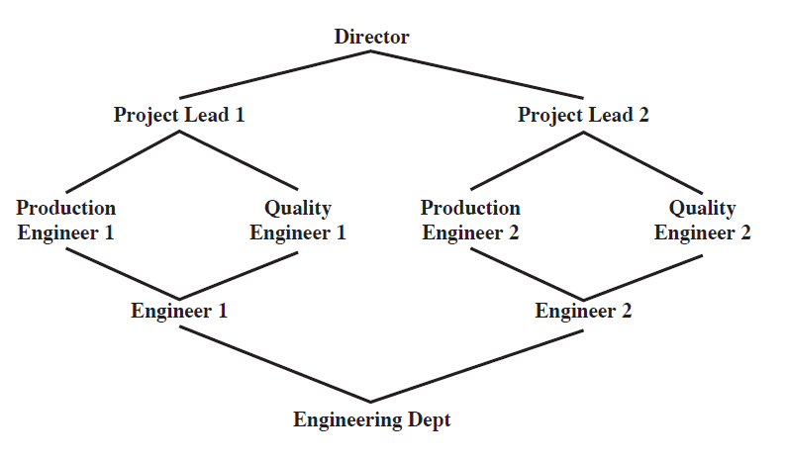
Example of Role Hierarchy
Notes:
Now define some basic concepts concerning UNIX files and directories.
All types of UNIX files are administered by the operating system by means of inodes. An inode (index node) is a control structure that contains the key information needed by the operating system for a particular file. Several file names may be associated with a single inode, but an active inode is associated with exactly one file, and each file is controlled by exactly one inode. The attributes of the file as well as its permissions and other control information are stored in the inode. On the disk, there is an inode table, or inode list, that contains the inodes of all the files in the file system. When a file is opened, its inode is brought into main memory and stored in a memory-resident inode table.
Directories are structured in a hierarchical tree. Each directory can contain files and/or other directories. A directory that is inside another directory is referred to as a subdirectory. A directory is simply a file that contains a list of file names plus pointers to associated inodes. Thus, associated with each directory is its own inode.

Slide 24
Constraints
A constraint is a defined relationship among roles, or a condition related to roles. Three types of constraints:
Mutually exclusive roles are roles such that a user can be assigned to only one role
The set of mutually exclusive roles should have non-overlapping permission (that is, for this type of roles, any permission can be granted to only one role)
The purpose is to increase the difficulty of collusion among individuals to thwart security policies
Cardinality refers to setting a maximum number with respect to roles
Prerequisite dictates that a user can only be assigned to a particular role if it is already assigned to some other specified role – used to structure the implementation of the least privilege
Notes:
Now define some basic concepts concerning UNIX files and directories.
All types of UNIX files are administered by the operating system by means of inodes. An inode (index node) is a control structure that contains the key information needed by the operating system for a particular file. Several file names may be associated with a single inode, but an active inode is associated with exactly one file, and each file is controlled by exactly one inode. The attributes of the file as well as its permissions and other control information are stored in the inode. On the disk, there is an inode table, or inode list, that contains the inodes of all the files in the file system. When a file is opened, its inode is brought into main memory and stored in a memory-resident inode table.
Directories are structured in a hierarchical tree. Each directory can contain files and/or other directories. A directory that is inside another directory is referred to as a subdirectory. A directory is simply a file that contains a list of file names plus pointers to associated inodes. Thus, associated with each directory is its own inode.

Slide 25

A Case Study: RBAC For a Bank
Dresdner Bank (one of Germany’s largest banking corporations, based in Frankfurt) used a simple DAC system prior 1990s – They later introduced an RBAC scheme
Roles are defined by a combination of official position and job function
A role hierarchy is defined in such a way that one role is superior to another if its position is superior and their functions are identical
E.g., Role B (in the table on next slide) may have as many or more access rights than Role A
Notes:
Now define some basic concepts concerning UNIX files and directories.
All types of UNIX files are administered by the operating system by means of inodes. An inode (index node) is a control structure that contains the key information needed by the operating system for a particular file. Several file names may be associated with a single inode, but an active inode is associated with exactly one file, and each file is controlled by exactly one inode. The attributes of the file as well as its permissions and other control information are stored in the inode. On the disk, there is an inode table, or inode list, that contains the inodes of all the files in the file system. When a file is opened, its inode is brought into main memory and stored in a memory-resident inode table.
Directories are structured in a hierarchical tree. Each directory can contain files and/or other directories. A directory that is inside another directory is referred to as a subdirectory. A directory is simply a file that contains a list of file names plus pointers to associated inodes. Thus, associated with each directory is its own inode.

Slide 26
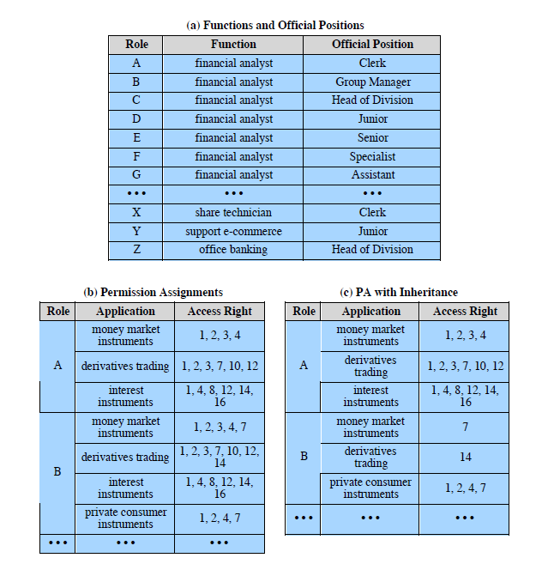
Roles and Their Access Rights
Notes:
The Dresdner Bank has implemented an RBAC system which is system wide and in which the determination of access rights is compartmentalized into three different administrative units for greater security. Roles within the organization are defined by a combination of official position and job function, and form a role hierarchy in which one role is superior to another if its position is superior and their functions are identical. This makes it possible to economize on access rights definitions.
When a user invokes an application, the application grants access on the basis of a centrally provided security profile. A separate authorization administration associated access rights with roles and creates the security profile for a use on the basis of the user's role. A user is statically assigned to up to 4 roles, and selects a given role for use in invoking a particular application. The user/role information is provided to the Authorization Administration, which creates a security profile for each user that associates the User ID and role with a set of access rights. A role may be used to access several applications. Thus, the set of access rights associated with a role may include access rights that are not associated with one of the applications the user invokes. All of these ingredients are depicted here in Figure 4.12.
Some figures about this system are of interest. Within the bank, there are 65 official positions. These positions are combined with 368 different job functions provided by the human resources database. Potentially, there are 23,920 different roles, but the number of roles in current use is about 1300. This is in line with the experience other RBAC implementations. On average, 42,000 security profiles are distributed to applications each day by the Authorization Administration module.

Slide 27
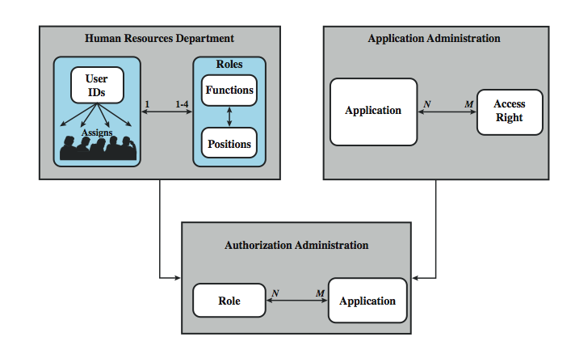
RBAC For a Bank
Notes:
The Dresdner Bank has implemented an RBAC system which is system wide and in which the determination of access rights is compartmentalized into three different administrative units for greater security. Roles within the organization are defined by a combination of official position and job function, and form a role hierarchy in which one role is superior to another if its position is superior and their functions are identical. This makes it possible to economize on access rights definitions.
When a user invokes an application, the application grants access on the basis of a centrally provided security profile. A separate authorization administration associated access rights with roles and creates the security profile for a use on the basis of the user's role. A user is statically assigned to up to 4 roles, and selects a given role for use in invoking a particular application. The user/role information is provided to the Authorization Administration, which creates a security profile for each user that associates the User ID and role with a set of access rights. A role may be used to access several applications. Thus, the set of access rights associated with a role may include access rights that are not associated with one of the applications the user invokes. All of these ingredients are depicted here in Figure 4.12.
Some figures about this system are of interest. Within the bank, there are 65 official positions. These positions are combined with 368 different job functions provided by the human resources database. Potentially, there are 23,920 different roles, but the number of roles in current use is about 1300. This is in line with the experience other RBAC implementations. On average, 42,000 security profiles are distributed to applications each day by the Authorization Administration module.

Slide 28
Some Interesting Figures
Within the bank, there are 65 official positions (ranging from a Clerk, through Branch Manager, to a Member of the Board)
These positions are combined with 368 job functions
Potentially, there are 23,920 different roles
The number of roles in current use is about 1,300
On average, 42,000 accesses are processed for different applications each day, by the Authorization Administration module
Notes:
Now define some basic concepts concerning UNIX files and directories.
All types of UNIX files are administered by the operating system by means of inodes. An inode (index node) is a control structure that contains the key information needed by the operating system for a particular file. Several file names may be associated with a single inode, but an active inode is associated with exactly one file, and each file is controlled by exactly one inode. The attributes of the file as well as its permissions and other control information are stored in the inode. On the disk, there is an inode table, or inode list, that contains the inodes of all the files in the file system. When a file is opened, its inode is brought into main memory and stored in a memory-resident inode table.
Directories are structured in a hierarchical tree. Each directory can contain files and/or other directories. A directory that is inside another directory is referred to as a subdirectory. A directory is simply a file that contains a list of file names plus pointers to associated inodes. Thus, associated with each directory is its own inode.

Slide 29
Bell-LaPadula (BLP) Model
It was developed in 1970s
Each subject and each object is assigned a security class
An object has a security classification
top secret > secret > confidential > restricted > unclassified
strategic > sensitive > confidential > public
A subject has a security clearance
Security classes control the manner by which a subject may access an object
29
Notes:
29
The BLP model was developed in the 1970s as a formal model for access
control. The model relied on the access control concept described in Chapter 4
(e.g., Figure 4.4 ). In the model, each subject and each object is assigned a security
class . In the simplest formulation, security classes form a strict hierarchy and
are referred to as security levels . One example is the U.S. military classification
scheme:
top secret > secret > confidential > restricted > unclassified
It is possible to also add a set of categories or compartments to each security
level, so that a subject must be assigned both the appropriate level and category to
access an object. We ignore this refinement in the following discussion.
This concept is equally applicable in other areas, where information can be
organized into gross levels and categories and users can be granted clearances to
access certain categories of data. For example, the highest level of security might be
for strategic corporate planning documents and data, accessible by only corporate
officers and their staff; next might come sensitive financial and personnel data,
accessible only by administration personnel, corporate officers, and so on. This
suggests a classification scheme such as
strategic > sensitive > confidential > public
A subject is said to have a security clearance of a given level; an object is said to
have a security classification of a given level. The security classes control the manner
by which a subject may access an object.

Slide 30
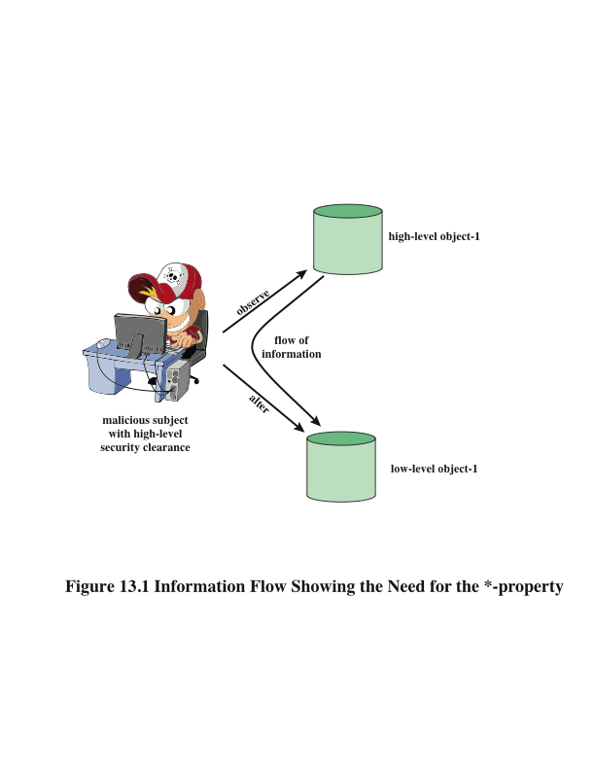
Two Properties
No read up
A subject can only read an object of less or equal security level
Referred to as the simple security property (ss-property)
No write down
Subject can only write into an object of greater or equal security level
referred to as the *-property
30
Notes:
30
Figure 13.1 illustrates the need for the *-property. Here, a malicious subject
passes classified information along by putting it into an information container
labeled at a lower security classification than the information itself. This will allow a
subsequent read access to this information by a subject at the lower clearance level.
These two properties provide the confidentiality form of what is known as
mandatory access control (MAC). Under this MAC, no access is allowed that does
not satisfy these two properties. In addition, the BLP model makes a provision for
discretionary access control (DAC).
• ds-property : An individual (or role) may grant to another individual (or role)
access to a document based on the owner’s discretion, constrained by the MAC
rules. Thus, a subject can exercise only accesses for which it has the necessary
authorization and which satisfy the MAC rules.
The basic idea is that site policy overrides any discretionary access controls.
That is, a user cannot give away data to unauthorized persons.

Slide 31
BLP Formal Description
Based on current state of system (b, M, f, H):
(current access set b, access matrix M, level function f, hierarchy H)
Three BLP properties:
ss-property: (S_{i}, O_{j}, read) has f_{c}(S_{i}) ≥ f_{o}(O_{j})
*-property: (S_{i}, O_{j}, append) has f_{c}(S_{i}) ≤ f_{o}(O_{j}) and
(S_{i}, O_{j}, write) has f_{c}(S_{i}) = f_{o}(O_{j})
ds-property: (S_{i}, O_{j}, A_{x}) implies A_{x} ∈ M[S_{i}, O_{j}]
31
Notes:
31
We use the notation presented in [BELL75]. The model is based on the concept of a
current state of the system. The state is described by the 4-tuple ( b , M , f , H ), defined
as follows:
• Current access set b : This is a set of triples of the form (subject, object, access-
mode). A triple ( s , o , a ) means that subject s has current access to o in access
mode a . Note that this does not simply mean that s has the access right a to o . The
triple means that s is currently exercising that access right; that is s is currently
accessing o by mode a .
Access matrix M : The access matrix has the structure indicated in Chapter 4 .
The matrix element M _{ij} records the access modes in which subject S _{i} is permitted
to access object O _{j} .
• Level function f : This function assigns a security level to each subject and
object. It consists of three mappings: f _{o} ( O _{j} ) is the classification level of object
O _{j} ; f _{s} ( S _{i} ) is the security clearance of subject S _{i} ; f _{c} ( S _{i} ) is the current security
level of subject S _{i} . The security clearance of a subject is the maximum security
level of the subject. The subject may operate at this level or at a lower level.
Thus, a user may log onto the system at a level lower than the user’s security
clearance. This is particularly useful in a role-based access control system.
• Hierarchy H : This is a directed rooted tree whose nodes correspond to objects
in the system. The model requires that the security level of an object must
dominate the security level of its parent. For our discussion, we may equate
this with the condition that the security level of an object must be greater than
or equal to its parent.
We can now define the three BLP properties more formally. For every subject
S _{i} and every object O _{j} , the requirements can be stated as follows:
• ss-property: Every triple of the form ( S _{i} , O _{j} , read) in the current access set b
has the property f_{c}(S_{i}) ≥ f_{o}(O_{j}) .
• *-property: Every triple of the form ( S _{i} , O _{j} , append) in the current access set b
has the property f_{c}(S_{i}) ≤ f_{o}(O_{j}) . Every triple of the form ( S _{i} , O _{j} , write) in the
current access set b has the property f _{c} ( S _{i} ) f _{o} ( O _{j} ).
• ds-property: If ( S _{i} , O _{j} , A _{x} ) is a current access (is in b ), then access mode A _{x}
is recorded in the ( S _{i} , O _{j} ) element of M . That is, ( S _{i} , O _{j} , A _{x} ) implies that
A_{x} ∈ M[S_{i},O_{j}] .
These three properties can be used to define a confidentiality secure system.
In essence, a secure system is characterized by the following:
1. The current security state of the system ( b , M , f , H ) is secure if and only if
every element of b satisfies the three properties.
2. The security state of the system is changed by any operation that causes a
change any of the four components of the system, ( b , M , f , H ).
3. A secure system remains secure so long as any state change does not violate
the three properties.
[BELL75] shows how these three points can be expressed as theorems using the
formal model. Further, given an actual design or implementation, it is theoretically
possible to prove the system secure by proving that any action that affects the state
of the system satisfies the three properties. In practice, for a complex system, such
a proof has never been fully developed. However, as mentioned earlier, the formal
statement of requirements can lead to a more secure design and implementation.

Slide 32
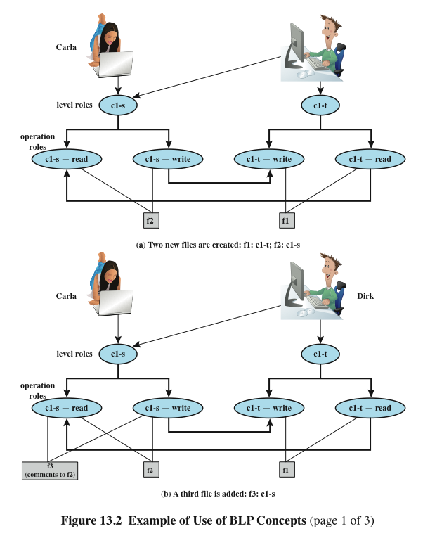
BLP Example (slide 1 of 3)
Notes:
32
An example, from [WEIP06] illustrates the operation of the BLP model and also
highlights a practical issue that must be addressed. We assume a role-based access
control system. Carla and Dirk are users of the system. Carla is a student (s) in
course c1. Dirk is a teacher (t) in course c1 but may also access the system as a
student; thus two roles are assigned to Dirk:
Carla: (c1-s)
Dirk: (c1-t), (c1-s)
The student role is assigned a lower security clearance and the teacher role a
higher security clearance. Let us look at some possible actions:
1. Dirk creates a new file f1 as c1-t; Carla creates file f2 as c1-s ( Figure 13.2a ).
Carla can read and write to f2, but cannot read f1, because it is at a higher
classification level (teacher level). In the c1-t role, Dirk can read and write f1
and can read f2 if Carla grants access to f2. However, in this role, Dirk cannot
write f2 because of the *-property; neither Dirk nor a Trojan horse on his
behalf can downgrade data from the teacher level to the student level. Only if
Dirk logs in as a student can he create a c1-s file or write to an existing c1-s file,
such as f2. In the student role, Dirk can also read f2.
2. Dirk reads f2 and wants to create a new file with comments to Carla as feedback.
Dirk must sign in student role c1-s to create f3 so that it can be accessed
by Carla ( Figure 13.2b ). In a teacher role, Dirk cannot create a file at a student
classification level.

Slide 33
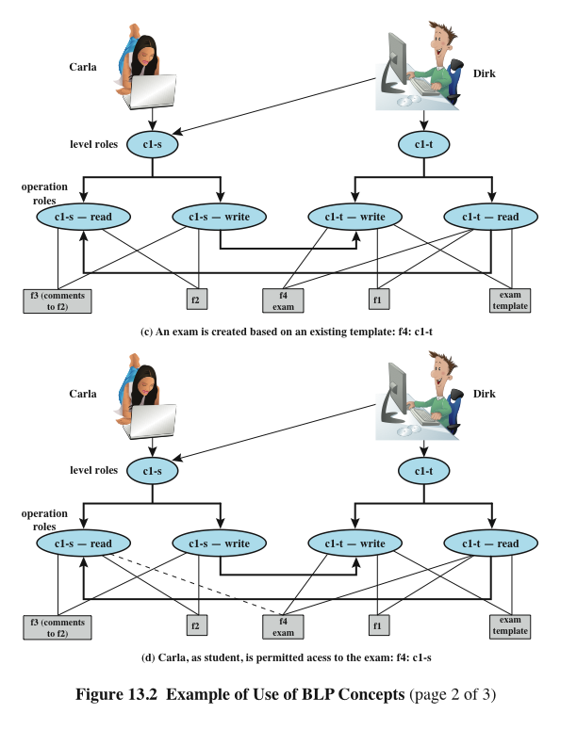
BLP Example (slide 2 of 3)
Notes:
33
Dirk creates an exam based on an existing template file store at level c1-t.
Dirk must log in as c1-t to read the template and the file he creates (f4) must
also be at the teacher level ( Figure 13.2c ).
4. Dirk wants Carla to take the exam and so must provide her with read access.
However, such access would violate the ss-property. Dirk must downgrade
the classification of f4 from c1-t to c1-s. Dirk cannot do this in the c1-t role
because this would violate the *-property. Therefore, a security administrator
(possibly Dirk in this role) must have downgrade authority and must be able to perform the
downgrade outside the BLP model. The dotted line in
Figure 13.2d connecting f4 with c1-s-read indicates that this connection has
not been generated by the default BLP rules but by a system operation.

Slide 34
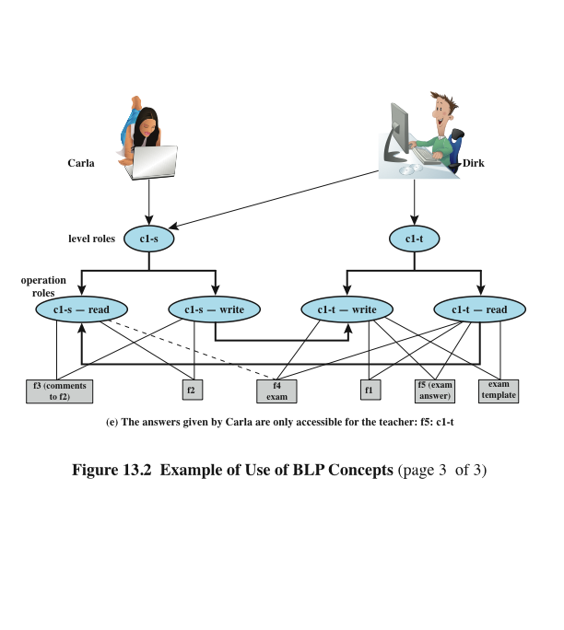
BLP Example (slide 3 of 3)
Notes:
34
5. Carla writes the answers to the exam into a file f5. She creates the file at
level c1-t so that only Dirk can read the file. This is an example of writing up,
which is not forbidden by the BLP rules. Carla can still see her answers at her
workstation but cannot access f5 for reading.
This discussion illustrates some critical practical limitations of the BLP
model. First, as noted in step 4, the BLP model has no provision to manage the
“downgrade” of objects, even though the requirements for multilevel security
recognize that such a flow of information from a higher to a lower level may be
required, provided it reflects the will of an authorized user. Hence, any practical
implementation of a multilevel system has to support such a process in a controlled
and monitored manner. Related to this is another concern. A subject constrained
by the BLP model can only be “editing” (reading and writing) a file at one security
level while also viewing files at the same or lower levels. If the new document
consolidates information from a range of sources and levels, some of that information
is now classified at a higher level than it was originally. This is known as classification
creep and is a well-known concern when managing multilevel information.
Again, some process of managed downgrading of information is needed to restore
reasonable classification levels.

Slide 35
Biba Integrity Model
It deals with integrity rather than confidentiality
Strict integrity policy, based on the following rules:
simple integrity: A subject can modify an object, only if I(S) ≥ I(O)
integrity confinement: A subject can read an object only if I(S) ≤ I(O)
35
Notes:
35
The BLP model deals with confidentiality and is concerned with unauthorized
disclosure of information. The Biba [BIBA77] models deals with integrity and is concerned
with the unauthorized modification of data. The Biba model is intended to
deal with the case in which there is data that must be visible to users at multiple or all
security levels but should only be modified in controlled ways by authorized agents.
The basic elements of the Biba model have the same structure as the BLP
model. As with BLP, the Biba model deals with subjects and objects. Each subject
and object is assigned an integrity level, denoted as I( S ) and I( O ) for subject S and
object O , respectively. A simple hierarchical classification can be used, in which there
is a strict ordering of levels from lowest to highest. As in the BLP model, it is also
possible to add a set of categories to the classification scheme; this we ignore here.
The model considers the following access modes:
• Modify: To write or update information in an object
• Observe: To read information in an object
• Execute: To execute an object
• Invoke: Communication from one subject to another
The first three modes are analogous to BLP access modes. The invoke mode is
new. Biba then proposes a number of alternative policies that can be imposed on this
model. The most relevant is the strict integrity policy, based on the following rules:
• Simple integrity: A subject can modify an object only if the integrity level of
the subject dominates the integrity level of the object: I( S ) ≥ I( O ).
• Integrity confinement: A subject can read an object only if the integrity level
of the subject is dominated by the integrity level of the object: I( S ) ≤ I( O ).
• Invocation property: A subject can invoke another subject only if the integrity
level of the first subject dominates the integrity level of the second subject:
I( S ₁ ) ≥ I( S ₂ ).
The first two rules are analogous to those of the BLP model but are concerned
with integrity and reverse the significance of read and write. The simple integrity rule
is the logical write-up restriction that prevents contamination of high-integrity data.
Figure 13.4 illustrates the need for the integrity confinement rule. A low-integrity
process may read low-integrity data but is prevented from contaminating a high integrity
file with that data by the simple integrity rule. If only this rule is in force, a
high-integrity process could conceivably copy low-integrity data into a high-integrity
file. Normally, one would trust a high-integrity process to not contaminate a high integrity
file, but either an error in the process code or a Trojan horse could result in
such contamination; hence the need for the integrity confinement rule.

Slide 36
Chinese Wall Model
This model is to use what (is referred to as a Chinese Wall) to prevent a conflict of interest
Example: A market analyst cannot be allowed to provide advice to one company when he has confidential information of a competitor
The elements of Chinese wall model
Subjects
Information: Objects / Dataset (DS) / Conflict of interest (CI) class
Access rules
The history of a subject’s previous access determines access control
Once a subject accesses information from one dataset, a wall is set up to protect information in the same CI
36
Notes:
36
The BLP model deals with confidentiality and is concerned with unauthorized
disclosure of information. The Biba [BIBA77] models deals with integrity and is concerned
with the unauthorized modification of data. The Biba model is intended to
deal with the case in which there is data that must be visible to users at multiple or all
security levels but should only be modified in controlled ways by authorized agents.
The basic elements of the Biba model have the same structure as the BLP
model. As with BLP, the Biba model deals with subjects and objects. Each subject
and object is assigned an integrity level, denoted as I( S ) and I( O ) for subject S and
object O , respectively. A simple hierarchical classification can be used, in which there
is a strict ordering of levels from lowest to highest. As in the BLP model, it is also
possible to add a set of categories to the classification scheme; this we ignore here.
The model considers the following access modes:
• Modify: To write or update information in an object
• Observe: To read information in an object
• Execute: To execute an object
• Invoke: Communication from one subject to another
The first three modes are analogous to BLP access modes. The invoke mode is
new. Biba then proposes a number of alternative policies that can be imposed on this
model. The most relevant is the strict integrity policy, based on the following rules:
• Simple integrity: A subject can modify an object only if the integrity level of
the subject dominates the integrity level of the object: I( S ) ≥ I( O ).
• Integrity confinement: A subject can read an object only if the integrity level
of the subject is dominated by the integrity level of the object: I( S ) ≤ I( O ).
• Invocation property: A subject can invoke another subject only if the integrity
level of the first subject dominates the integrity level of the second subject:
I( S ₁ ) ≥ I( S ₂ ).
The first two rules are analogous to those of the BLP model but are concerned
with integrity and reverse the significance of read and write. The simple integrity rule
is the logical write-up restriction that prevents contamination of high-integrity data.
Figure 13.4 illustrates the need for the integrity confinement rule. A low-integrity
process may read low-integrity data but is prevented from contaminating a high integrity
file with that data by the simple integrity rule. If only this rule is in force, a
high-integrity process could conceivably copy low-integrity data into a high-integrity
file. Normally, one would trust a high-integrity process to not contaminate a high integrity
file, but either an error in the process code or a Trojan horse could result in
such contamination; hence the need for the integrity confinement rule.

Slide 37
Two Rules of Chinese Wall Model
Simple security rule:
A subject S can read on object O only if
O is in the same DS as an object already accessed by S, OR
O belongs a CI from which S has not yet accessed any Information
*-property rule:
A subject S can write an object O only if
S can read O according to the simple security rule, AND
All objects that S can read are in the same DS as O
37
Notes:
37
The BLP model deals with confidentiality and is concerned with unauthorized
disclosure of information. The Biba [BIBA77] models deals with integrity and is concerned
with the unauthorized modification of data. The Biba model is intended to
deal with the case in which there is data that must be visible to users at multiple or all
security levels but should only be modified in controlled ways by authorized agents.
The basic elements of the Biba model have the same structure as the BLP
model. As with BLP, the Biba model deals with subjects and objects. Each subject
and object is assigned an integrity level, denoted as I( S ) and I( O ) for subject S and
object O , respectively. A simple hierarchical classification can be used, in which there
is a strict ordering of levels from lowest to highest. As in the BLP model, it is also
possible to add a set of categories to the classification scheme; this we ignore here.
The model considers the following access modes:
• Modify: To write or update information in an object
• Observe: To read information in an object
• Execute: To execute an object
• Invoke: Communication from one subject to another
The first three modes are analogous to BLP access modes. The invoke mode is
new. Biba then proposes a number of alternative policies that can be imposed on this
model. The most relevant is the strict integrity policy, based on the following rules:
• Simple integrity: A subject can modify an object only if the integrity level of
the subject dominates the integrity level of the object: I( S ) ≥ I( O ).
• Integrity confinement: A subject can read an object only if the integrity level
of the subject is dominated by the integrity level of the object: I( S ) ≤ I( O ).
• Invocation property: A subject can invoke another subject only if the integrity
level of the first subject dominates the integrity level of the second subject:
I( S ₁ ) ≥ I( S ₂ ).
The first two rules are analogous to those of the BLP model but are concerned
with integrity and reverse the significance of read and write. The simple integrity rule
is the logical write-up restriction that prevents contamination of high-integrity data.
Figure 13.4 illustrates the need for the integrity confinement rule. A low-integrity
process may read low-integrity data but is prevented from contaminating a high integrity
file with that data by the simple integrity rule. If only this rule is in force, a
high-integrity process could conceivably copy low-integrity data into a high-integrity
file. Normally, one would trust a high-integrity process to not contaminate a high integrity
file, but either an error in the process code or a Trojan horse could result in
such contamination; hence the need for the integrity confinement rule.

Slide 38
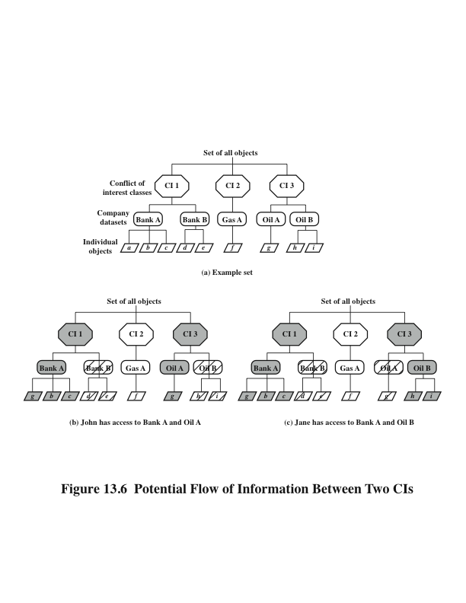
Chinese Wall Model
Notes:
38
The Chinese Wall Model (CWM) takes a quite different approach to specifying
integrity and confidentiality than any of the approaches we have examined so far.
The model was developed for commercial applications in which conflicts of interest
can arise. The model makes use of both discretionary and mandatory access concepts.
The principal idea behind the CWM is a concept that is common in the financial
and legal professions, which is to use a what is referred to as a Chinese wall to prevent
a conflict of interest. An example from the financial world is that of a market analyst
working for a financial institution providing corporate business services. An analyst
cannot be allowed to provide advice to one company when the analyst has confidential
information (insider knowledge) about the plans or status of a competitor. However,
the analyst is free to advise multiple corporations that are not in competition with
each other and to draw on market information that is open to the public.
The elements of the model are the following:
• Subjects: Active entities that may wish to access protected objects; includes
users and processes
• Information: Corporate information organized into a hierarchy with three levels:
— Objects: Individual items of information, each concerning a single
corporation
— Dataset (DS): All objects that concern the same corporation
— Conflict of interest (CI) class: All datasets whose corporations are in
competition
• Access rules: Rules for read and write access
Figure 13.6a gives an example. There are datasets representing banks, oil
companies, and gas companies. All bank datasets are in one CI, all oil company
datasets in another CI, and so forth.
In contrast to the models we have studies so far, the CWM does not assign security
levels to subjects and objects and is thus not a true multilevel secure model. Instead, the
history of a subject’s previous access determines access control. The basis of the Chinese
wall policy is that subjects are only allowed access to information that is not held to conflict
with any other information that they already possess. Once a subject accesses information
from one dataset, a wall is set up to protect information in other datasets in the same CI.
The subject can access information on one side of the wall but not the other side. Further,
information in other CIs is initially not considered to be on one side or the other of the
wall but out in the open. When additional accesses are made in other CIs by the same
subject, the shape of the wall changes to maintain the desired protection. Further, each
subject is controlled by his or her own wall—the walls for different subjects are different.
To enforce the Chinese wall policy, two rules are needed. To indicate the similarity
with the two BLP rules, the authors gave them the same names. The first rule
is the simple security rule:
Simple security rule: A subject S can read on object O only if
• O is in the same DS as an object already accessed by S, OR
• O belongs to a CI from which S has not yet accessed any information
Figures 13.6b and c illustrate the operation of this rule. Assume that at some
point, John has made his first read request to any object in this set for an object in
the Bank A DS. Because John has not previously accessed an object in any other
DS in CI 1, the access is granted. Further, the system must remember that access
has been granted so that any subsequent request for access to an object in the Bank
B DS will be denied. Any request for access to other objects in the Bank A DS is
granted. At a later time, John requests access to an object in the Oil A DS. Because
there is no conflict, this access is granted, but a wall is set up prohibiting subsequent
access to the Oil B DS. Similarly, Figure 13.6c reflects the access history of Jane.
The simple security rule does not prevent an indirect flow of information that
would cause a conflict of interest. In our example, John has access to Oil A DS and
Bank A DS; Jane has access to Oil B DS and Bank A DS. If John is allowed to read
from the Oil A DS and write into the Bank A DS, John may transfer information
about Oil A into the Bank A DS; this is indicated by changing the value of the first
object under the Bank A DS to g . The data can then subsequently be read by Jane.
Thus, Jane would have access to information about both Oil A and Oil B, creating
a conflict of interest. To prevent this, the CWM has a second rule:
*-property rule: A subject S can write an object O only if
• S can read O according to the simple security rule, AND
• All objects that S can read are in the same DS as O.
Put another way, either subject cannot write at all, or a subject’s access (both
read and write) is limited to a single dataset. Thus, in Figure 13.6 , neither John nor
Jane has write access to any objects in the overall universe of data.
The *-property rule is quite restrictive. However, in many cases, a user only
needs read access because the user is performing some analysis role.
To somewhat ease the write restriction, the model includes the concept
of sanitized data . In essence, sanitized data are data that may be derived from
corporate data but that cannot be used to discover the corporation’s identity. Any
DS consisting solely of sanitized data need not be protected by a wall; thus the two
CWM rules do not apply to such DSs.

Slide 39
Summary
we have studied:
Access control principles
Subjects, objects, access rights
Discretionary access control
Role-based access control
A case study
Three access control models

Slide 40

Questions?

